Slide 1
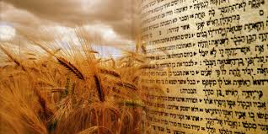
Shavuot Quiz Time!!
It’s Shavuot over half term, but apart from something vague about cheesecake, what do you really know about this festival?
Time for a Google Quiz!

Slide 2
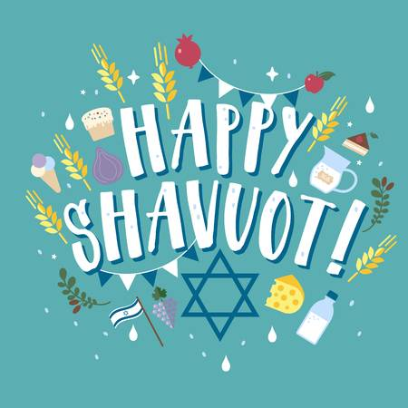
Here we go:
What is the Hebrew date of Shavuot?
What English date does Shavuot fall on this year?
What English date will it fall on next year?
Why does it fall on a different English date each year?
What verse in the Torah describes the giving of the Torah? Quote the verse.
What is the Omer?
Which Talmudic sage is linked with the Omer?
What are the main traditions of the Omer?
What does Tikkun Leyl Shavuot mean?
What book is read on Shavuot?
Why is that particular book associated with Shavuot?
What foods are associated with Shavuot?
Why are those particular foods associated with Shavuot?
Shavuot is one of 3 special festivals in the Jewish calendar. What are the other two and what links them?
What additional prayers are said in shul on Shavuot and why?
What are ‘bikkurim’ and why are they associated with Shavuot?
What is the name of the Christian holiday celebrated at the same time as Shavuot?
BONUS QUESTION – Shavuot is one of the least well known-about festivals in Judaism. Why do you think that is?

